Slide 1
Classification in Machine Learning Chris Harvey

Slide 2


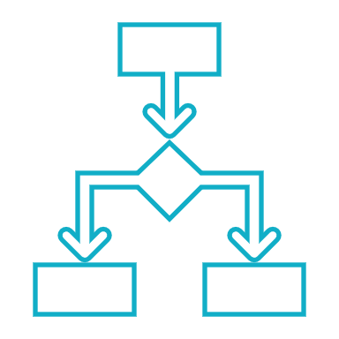
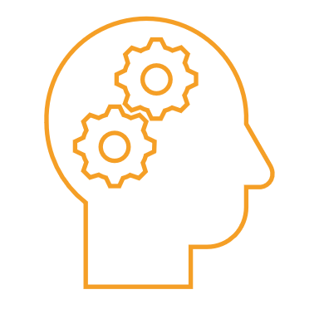
Project analysis slide 2
What we will cover
General Overview
SKLearn
PROJECT
Deep Learning
Boosting Machines
Results
Final Thoughts

Slide 3
General Overview
There are many different paradigms in machine learning. I want to go through the more prevalent ones and compare and contrast them to help people understand what they are and how to use them best.
In my notebooks I go through them in depth and give examples of how they work and the resources needed to learn them. Here I want to give a general overview of the topics I covered and the results of this experiment.
I will cover boosting machines, classical and deep learning for the use of classification of data. I will also cover Reinforcement learning in passing and the possible use cases of it. This will be a broad summation of the models available as there are hundreds of machine learning models that have been created if not thousands!
In the notebooks and in the README of the github repo I have added some fantastic resources to learn machine learning and data science! If you somehow see this slide deck before seeing the repo I highly recommend you read that!

Slide 4

Project analysis slide 3
SKLearn In a nutshell
All of your favorite models in one place!
Data Preprocessing built in!
Cost Effective!
Easy to tune!
Easy Presentation!
SKLearn is a collection of machine learning models and tools that allow the user to create any classical model they desire. Including Data augmentation!
There are many ways to do feature engineering and data processing already built into the SKLearn library. Just plug and play!
Training these models is a very quick process.
They only require some very basic hyperparameter tuning and feature engineering!
There are a vast number of automatic optimization tuning algorithms for every model in SKLearn!
Because SKLearn is compatible with MatPlotLib and Seaborn you can display your data very easily with the built-in visualization tools!

Slide 5
Project analysis slide 4
Neural Networks How do they work?
Deep Learning uses ‘Neural Networks’. These are modeled after the way our brain works. They add numbers and create ‘feature paths’ for how the data is processed.
The lines between each circle or ‘neuron’ are called ‘weights’. These are numbers that are multiplied by the inputs and decide how the model learns. They are updated using Gradient Descent and the chain rule of calculus.
Tasks
This is our input. Usually a numerical value used to represent our data.
Input 1
This is our output usually a value between 0 and 1 for how likely the outcome is.
Hidden Layer 1
Hidden Layer 2
Output
They are able to classify any type of data from images to text to numbers.
Input 2
Resources
.

Slide 6
Project analysis slide 8
Is Deep Learning
Worth it?
POSITIVE
NEGATIVE
Highest accuracy on every problem.
Can be bootstrapped to solve very complex problems.
Requires less data to make accurate predictions and is more resistant to noise then classical models.
Less interpretable. More of a ‘Black Box’.
Computationally expensive and SLOW at scale.
Harder to create then classical models and is newer with less helpful resources for production.
Deep
Is almost as accurate as Deep learning on most problems.
Very interpretable as every decision can be viewed.
Fast to train on data of any scale.
Can be unable to learn very complex problems that require multiple steps of learning.
Are VERY hard to tune and has a large learning curve on how to do it.
Boosting

Slide 7
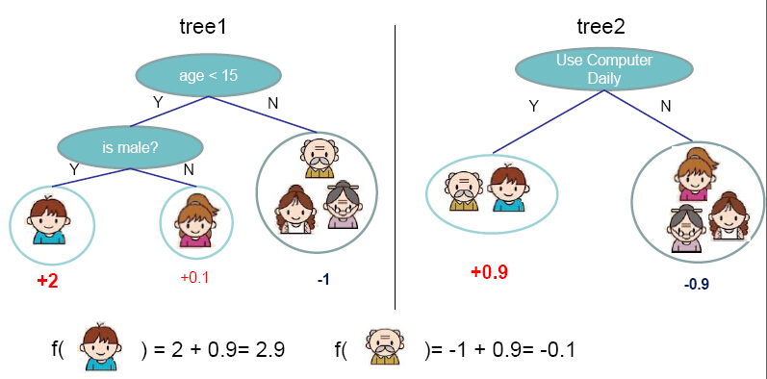
Boosting Machines What are they?
Gradient Boosting Machines are a series of ‘weak’ models that are added together to help classify any given problem.
They use gradient descent after each model is done running and create new trees along the gradient which then makes the model more robust. Every new model added will be able to tackle some aspect of the data that the model deems ‘difficult’. After enough weak models are added the model will be able to make very accurate collective ‘votes’ on what each piece of data should be classified as.

Slide 8
Project analysis slide 10
How did they do?
Here is a chart of the various outcomes on the Wine dataset. One thing to note is that the Deep Learning model was only trained using 10 epochs and could reach a higher accuracy given more training time.
The only reason the epochs were limited was for computation speed of the entire notebook. Deep Learning is notoriously slow to train and I wanted to not create something that would take 10 hours to train!
Other then that this is a fair comparison between each model. We can see that our standard models do not compare well to the state of the art models on the right.

Slide 9
Final Thoughts
Even though SKLearn is already SO well developed I think the models in there library are too outdated and are easily beaten in accuracy and training speed at scale by LightGBM and Deep Learning. We might not need the classical models unless we are doing very, very easy classification tasks such as those of the Iris dataset where there are only 150 samples and 4 features.
When you start getting into the millions of samples and dozens of features the old classical models just fall apart. We need to either add the new guard into our old libraries or give the past up! We can not be stuck at a time when our technology is doubling every 3 years!
I do respect all of the effort and love that has gone into creating this community and how open source and free it is! I hope to be able to contribute to it with my projects and work that I do. If this notebook helped anyone learn that is enough for me!
Thank you so much for taking the time to read and go through my project :D

Slide 10
Thank You

